Slide 1

Java/J2EE Session - 1
Introduction and Basic Concepts of Java.

Slide 2
Agenda for the day
Introduction and What is Java Virtual Machine (JVM)., Java Development Kit (JDK), Java Runtime Environment (JRE).
Difference JDK vs JRE.
Installing and configuring JDK.
The main method.
Writing and Understanding the first Hello World Program.
A First Program in Java: Printing a Line of Text.
Compiling the first Java program.
Understanding the basic concepts of Source and class files.
Describe a very basic Java source file. Class, methods, properties, package, imports etc.
What is an IDE.
Availale IDEs in market.
Configuring the Eclipse.
Java Program: Running our Hello World application using eclipse
Assignment

Slide 3
Introduction
Q) What is Java ?
1) Java is a general-purpose computer programming language that is concurrent, class-based, object-oriented.
2) It is intended to let application developers "write once, run anywhere" (WORA). Meaning that compiled Java code can run on all platforms that support Java without the need for recompilation.
3) Java applications are typically compiled to bytecode that can run on any Java virtual machine (JVM) regardless of computer architecture.

Slide 4
Introduction
Principles
There were five primary goals in the creation of the Java language:[16]
It must be "simple, object-oriented, and familiar".
It must be "robust and secure".
It must be "architecture-neutral and portable".
It must execute with "high performance".
It must be "interpreted, threaded, and dynamic".

Slide 5
Advantages
Advantages of Java:
Simple: Java was designed to be easy to use, write, compile, debug, and learn than other programming languages. Java is much simpler than C++ because Java uses automatic memory allocation and garbage collection.
Object-Oriented: Allows you to create modular programs and reusable code.
Platform-Independent: Ability to move easily from one computer system to another
Distributed: Designed to make distributed computing easy with the networking capability that is inherently integrated into it.
Secure: The Java language, compiler, interpreter, and runtime environment were each developed with security in mind.
Allocation: Java has the feature of Stack allocation system. It helps the data to be stored and can be restored easily.
Multithreaded: The capability for a program to perform several tasks simultaneously within a program.

Slide 6
Disadvantages of Java
Disadvantages of Java:
Performance: SIgnificantly slower and more memory-consuming than natively compiled languages such as C or C++.
Look and feel: The default look and feel of GUI applications written in Java using the Swing toolkit is very different from native applications.
Single-paradigm language: The addition of static imports in Java 5.0 the procedural paradigm is better accommodated than in earlier versions of Java.

Slide 7
JDK
Q) What is JDK?
It is a bundle of software that you can use to develop Java based applications.
Java Development Kit is needed for developing java applications.
The JDK needs more Disk space as it contains the JRE along with various development tools.
The JDK can be downloaded/supported freely from https://www.oracle.com/technetwork/java/javase/downloads/
It includes the JRE, set of API classes, Java compiler, Webstart and additional files needed to write Java applets and applications.

Slide 8
JRE
Q) What is a JRE?
It is an implementation of the Java Virtual Machine* which actually executes Java programs.
Java Runtime Environment is a plug-in needed for running java programs.
The JRE is smaller than the JDK so it needs less Disk space.
It includes the JVM , Core libraries and other additional components to run applications and applets written in Java.

Slide 9
JVM (Java Virtual Machine)
Q) What is JVM ?
It is:
A specification where working of Java Virtual Machine is specified. But implementation provider is independent to choose the algorithm. Its implementation has been provided by Sun and other companies.
An implementation Its implementation is known as JRE (Java Runtime Environment).
Runtime Instance Whenever you write java command on the command prompt to run the java class, an instance of JVM is created.

Slide 10
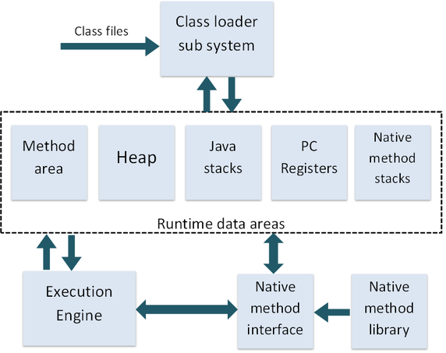
JVM Architecture

Slide 11
JVM Architecture
1) Classloader :Classloader is a subsystem of JVM that is used to load class files.
2) Class(Method) Area : Class(Method) Area stores per-class structures such as the runtime constant pool, field and method data, the code for methods.
3) Heap: It is the runtime data area in which objects are allocated.
4) Stack: Java Stack stores frames.It holds local variables and partial results, and plays a part in method invocation and return.
5) Program Counter Register: PC (program counter) register. It contains the address of the Java virtual machine instruction currently being executed.
6) Native Method Stack: It contains all the native methods used in the application.
7) Execution Engine
1) A virtual processor
2) Interpreter: Read bytecode stream then execute the instructions.
3) Just-In-Time(JIT) compiler: It is used to improve the performance.JIT compiles parts of the byte code that have similar functionality at the same time, and hence reduces the amount of time needed for compilation.Here the term ?compiler? refers to a translator from the instruction set of a Java virtual machine (JVM) to the instruction set of a specific CPU.

Slide 12
JVM (Java Virtual Machine)
What it does
Loads code
Verifies code
Executes code
Provides runtime environment
JVM provides definitions for the:
Memory area
Class file format
Register set
Garbage-collected heap
Fatal error reporting etc.

Slide 13

Installing and Configuring.
1) Verifying the current Java Version.
Open command prompt and type the below command and say enter.
java -version
2) The version must be at least 1.7.
Open command prompt and type the below command and say enter.
java -version

Slide 14
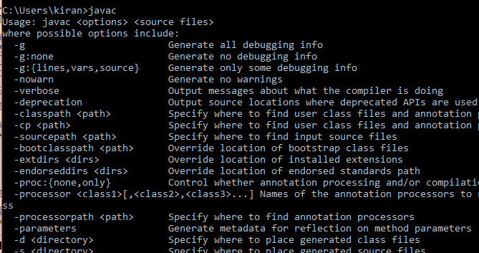
Syntax to declare a variable
3) Verify the below 2 commands.
javac: if you get the below screen then your JDK is working fine.

Slide 15
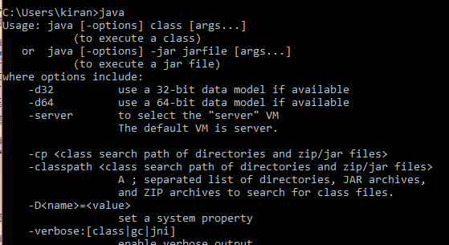
Installing and Configuring.
java
If you get the below output then your JRE is working.

Slide 16
Installing and Configuring.
If any of the step fails, then we need to install and configure the JDK/JRE.
Download JDK from the below path.
http://www.oracle.com/technetwork/java/javase/downloads/jdk8-downloads-2133151.html
Set Below Environment Variables.
JAVA_HOME: location of your java installation location.
Example: JAVA_HOME=C:\Program Files\Java\jdk1.8.0_65
Path: This has to be set to the Java homes bin directory.
Example: Path=%JAVA_HOME%\bin

Slide 17
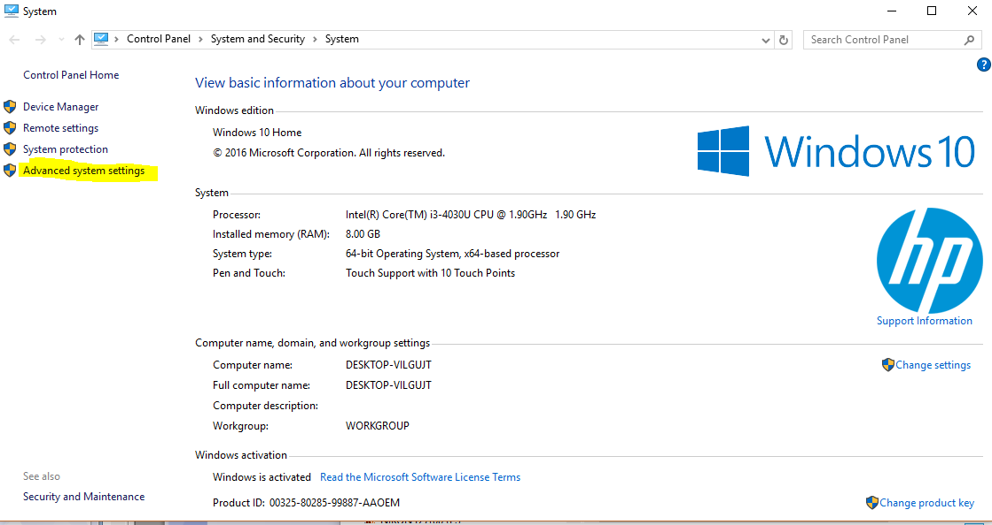
Installing and Configuring
Click on “Advance System settings”

Slide 18
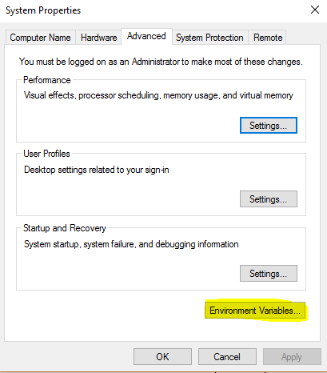
Installing and Configuring
Click on “Environment Variables”

Slide 19
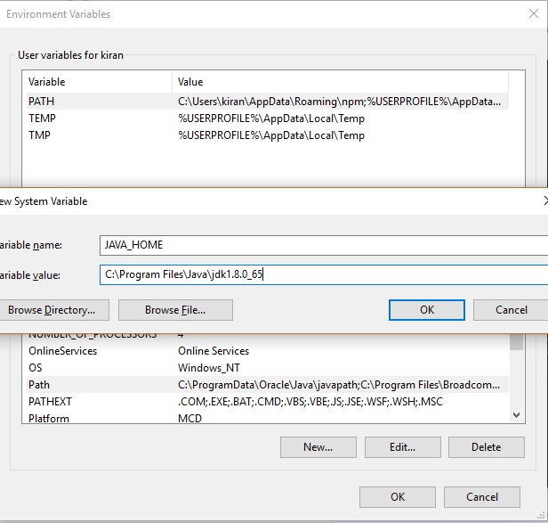
Installing and Configuring
Click on “New” Under System Variable group

Slide 20
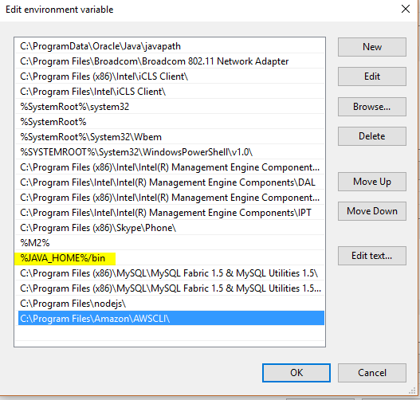
Installing and Configuring
Under System Variables find the variable with name Path as show in screen shot below
Select that variable and click on Edit. Under edit dialog, click on New and add the highlighted line then click OK.

Slide 21
Installinga and Configuring.
Once all the steps are done, then verify the installation again by typing below commands in command line.
Command 1 : java -version
Command 2 : javac
Command 3 : java
If the response is same the screen shots shown before then you are up and running in Java and read to write your first Java Program.

Slide 22

Any Questions on current topic

